Slide 1
ANVESHAN HACKATHON 2025
ANVESHAN HACKATHON 2025
Title - FREELANCE MARKETPLACE
Theme- FINANCE
PS category – Software Development
NAME – NAMRTA RANI
Student code – IITMCS_24095854

Slide 2
Proposed Solution (Describe your Idea/Solution/Prototype) Creating a Freelancing App which is free from all the bugs and problems already present in existing apps. An app that addresses the common problems faced by freelancers while using the apps.
ANVESHAN HACKATHON 2025

Slide 3
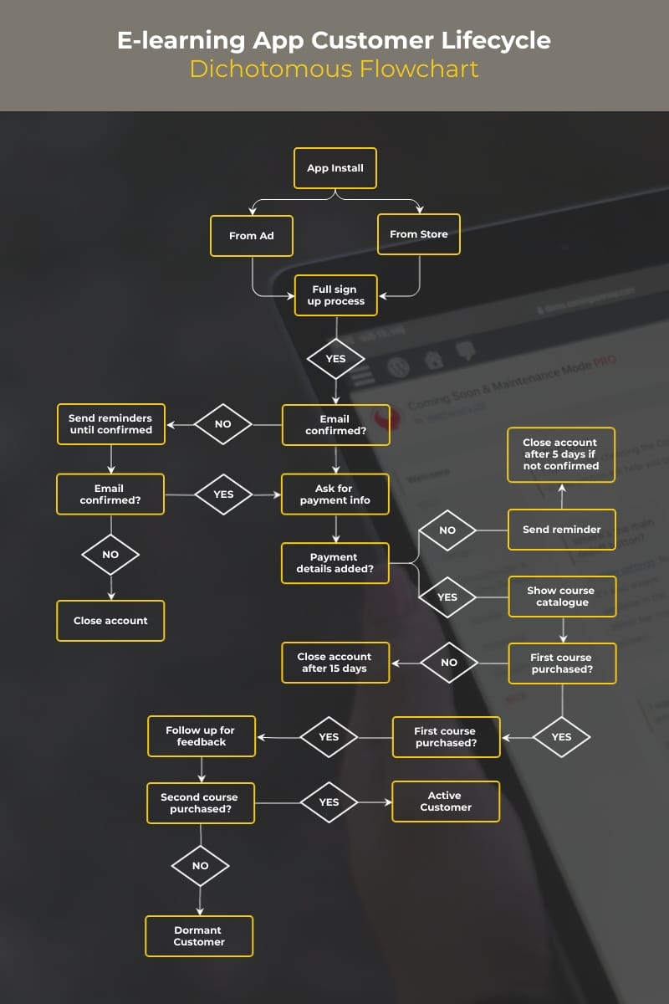

Slide 4
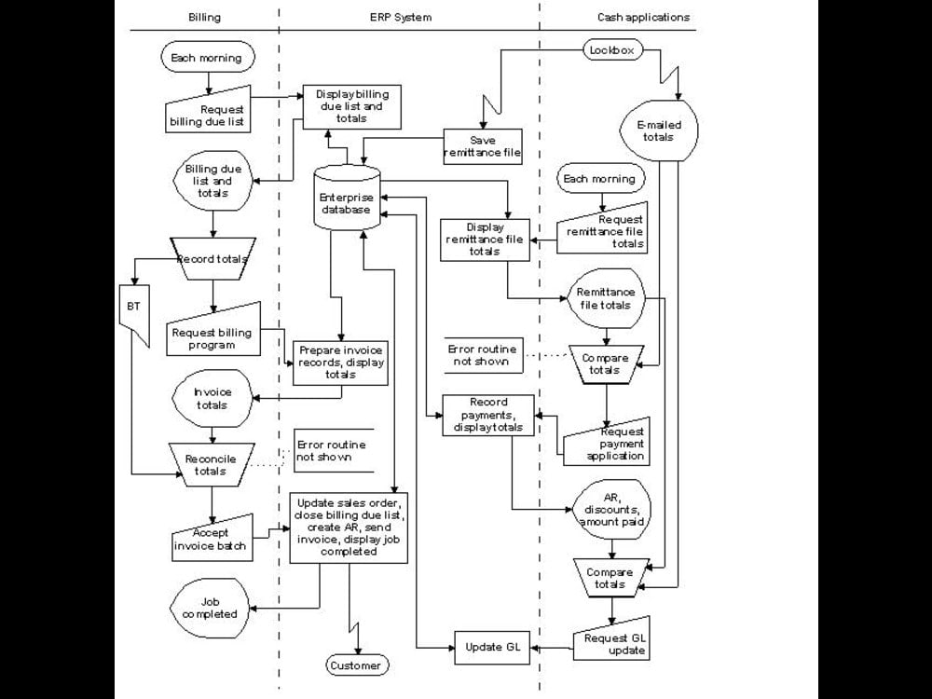
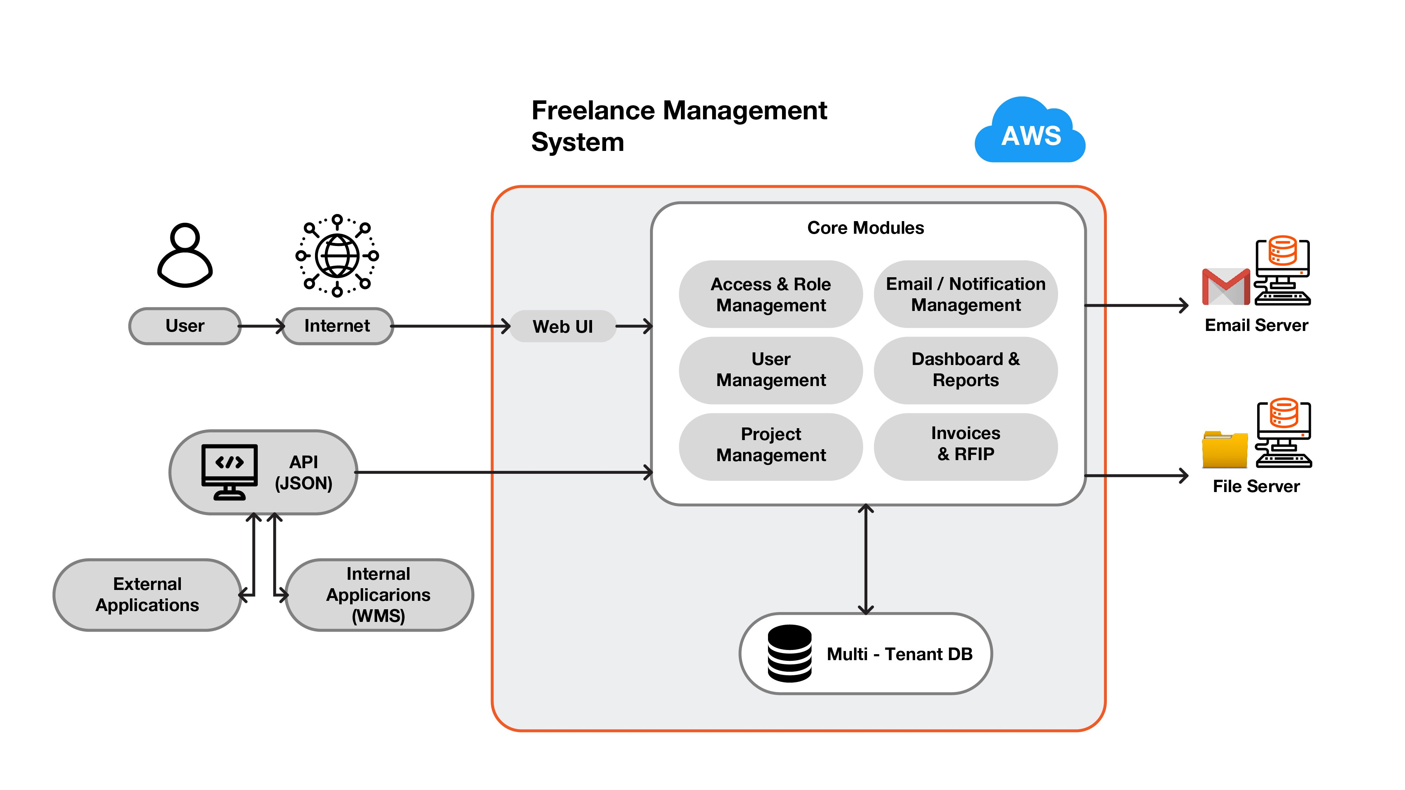
TECHNICAL APPROACH
ANVESHAN HACKATHON 2025
For frontend we use React.js and for the backend we use Node.js
Flowcharts of freelancing apps

Slide 5
FEASIBILITY AND VIABILITY
ANVESHAN HACKATHON 2025
This is an easy app idea as it basically focuses on eradicating the challenges faced by independent online workers.
Major challenges while creating and testing this app could be bugs in the system UI and bad app reviews.
To overcome the challenges like bugs in the system we could roll out timely patch updates with lots of new changes making the app more competitive and wanted. And for the reviews, they could be the most helpful for us as they help us to know problems faced by people.

Slide 6
IMPACT AND BENEFITS
ANVESHAN HACKATHON 2025
A large population of India belongs to the middle class and this app mainly focuses on working as a side hustle for them. People don’t need to put in most of their time they could just earn some amount with really low investment.
The most important benefit which people can get from this app is the commission charged over here is very low as compared to others and also people can withdraw their earnings easily through any payment gateway like UPI and Internet banking through their local banks. This app mainly helps people with some talent to get paid for little time investment and more intellect.

Slide 7
ANVESHAN HACKATHON 2025
RESEARCH AND REFERENCES
Purr web
Current Economic Scenario Of Developing India

